Slide 1

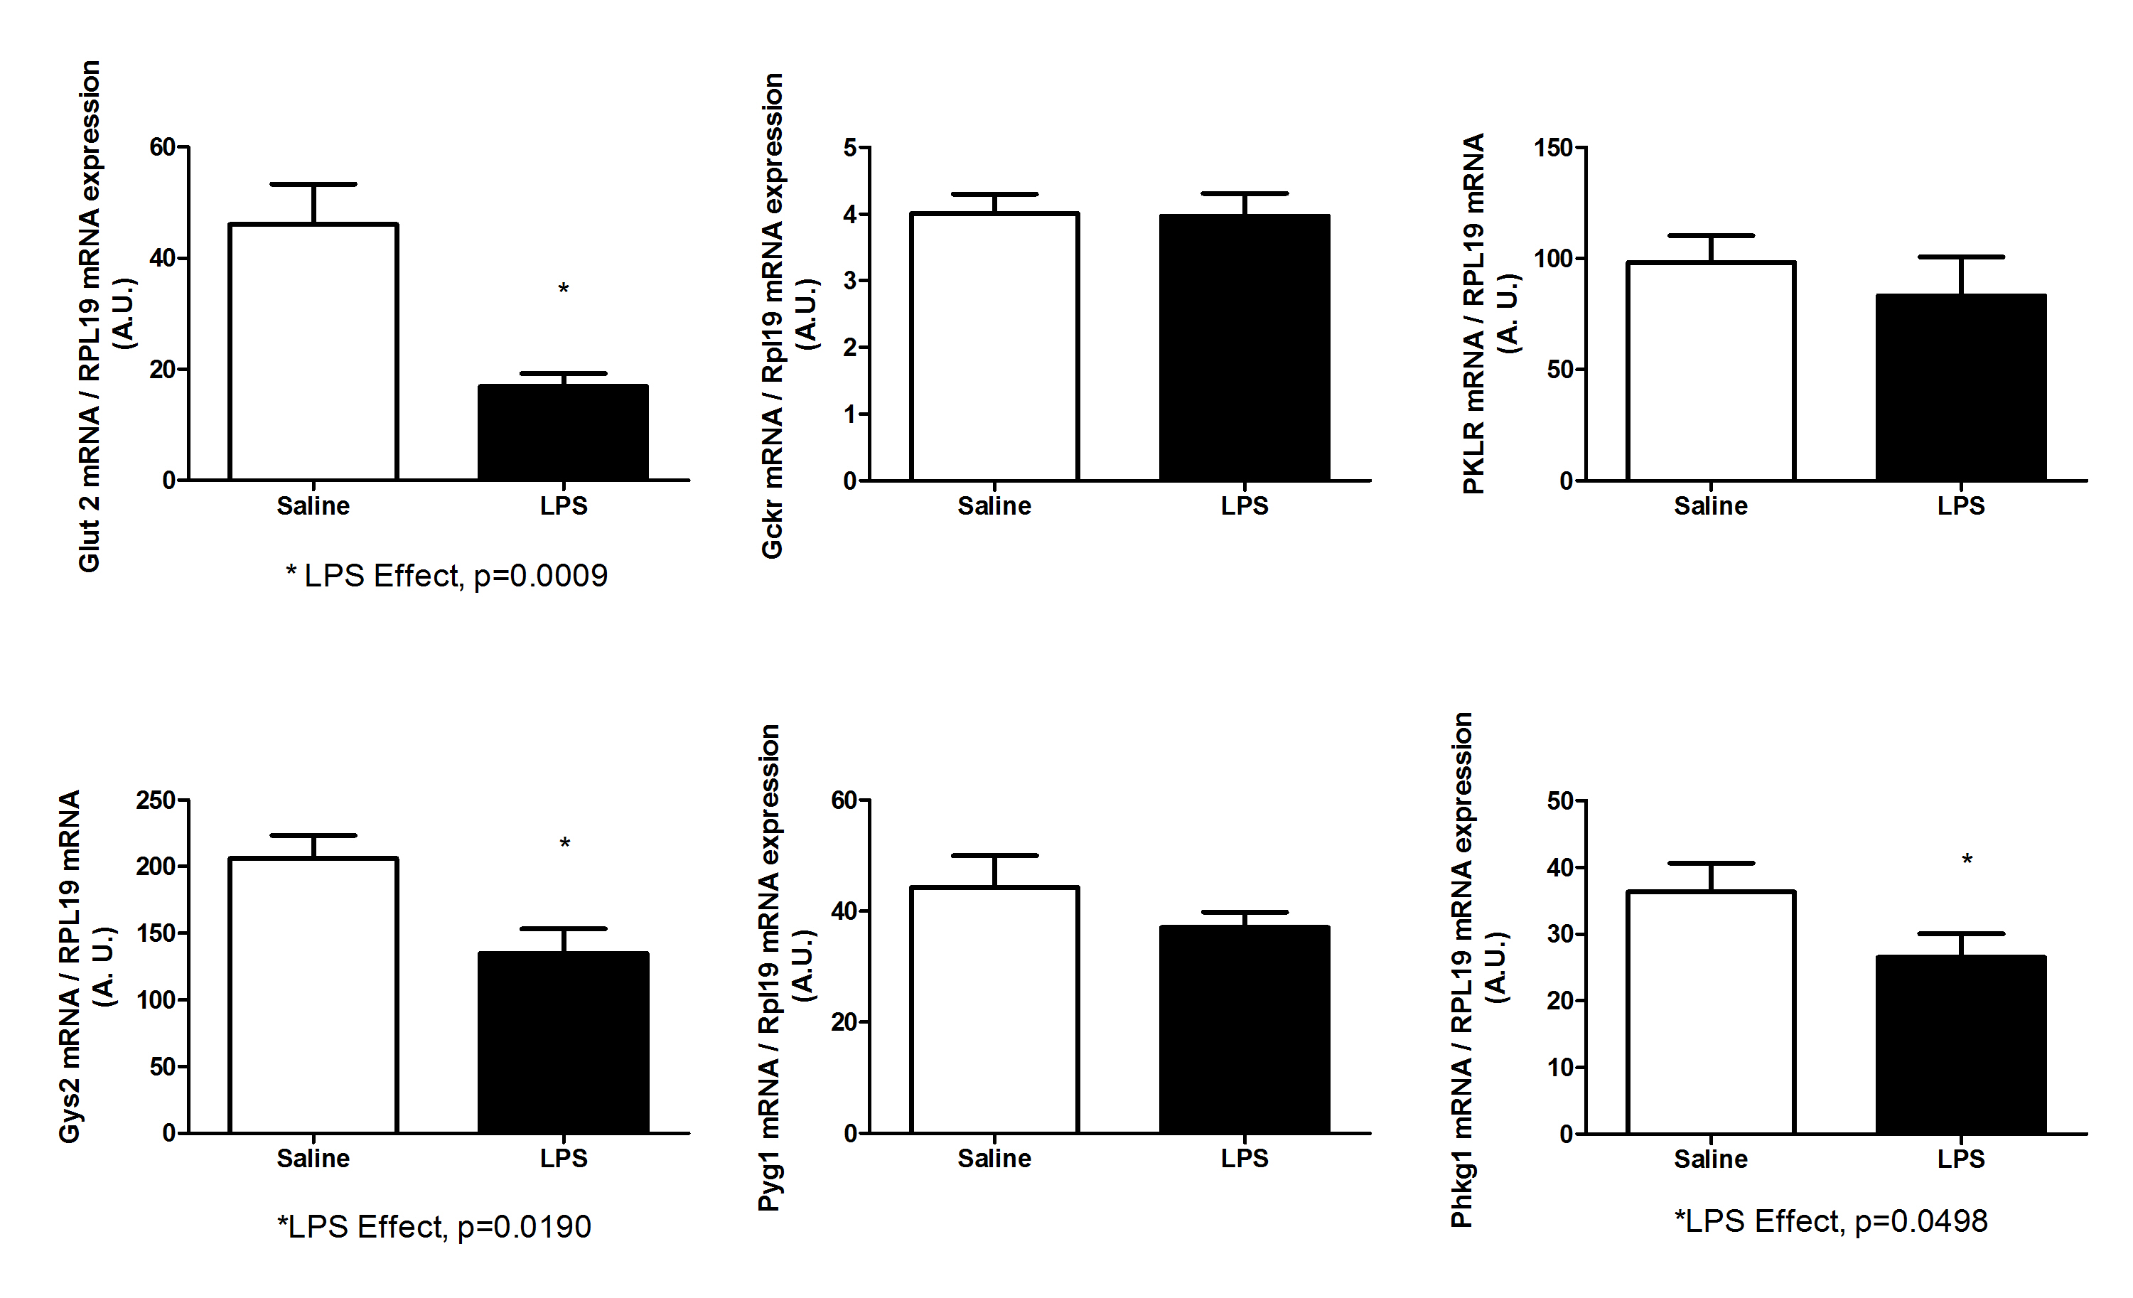
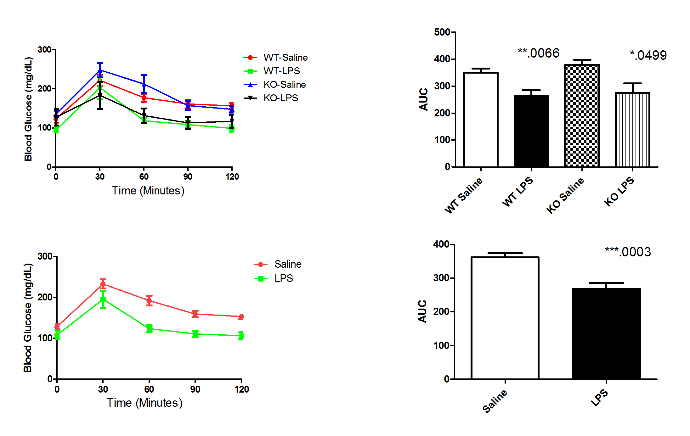
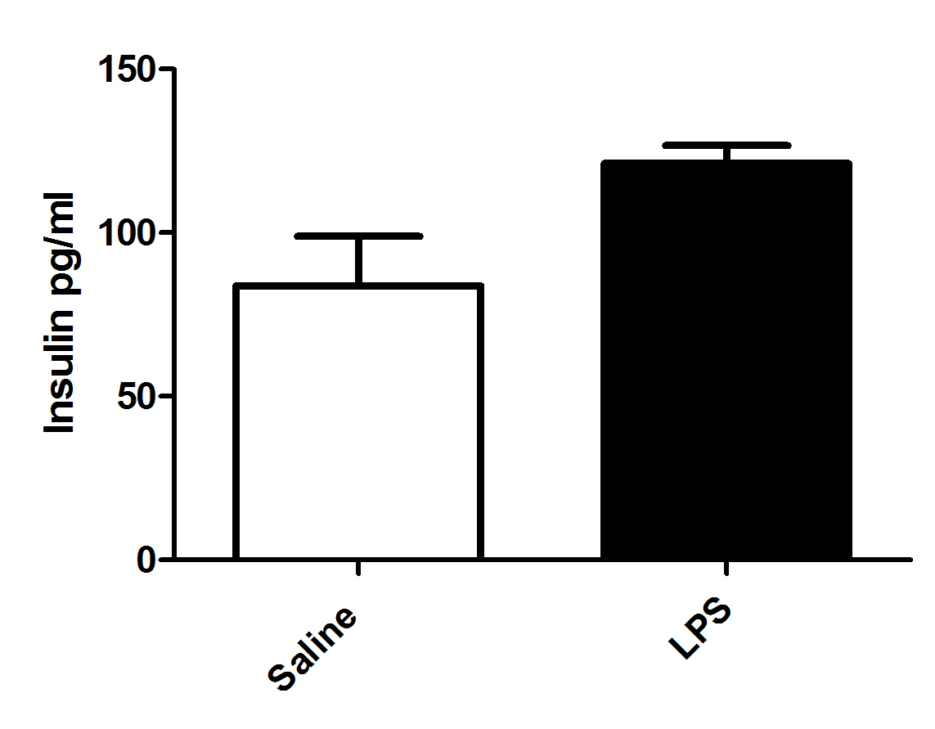
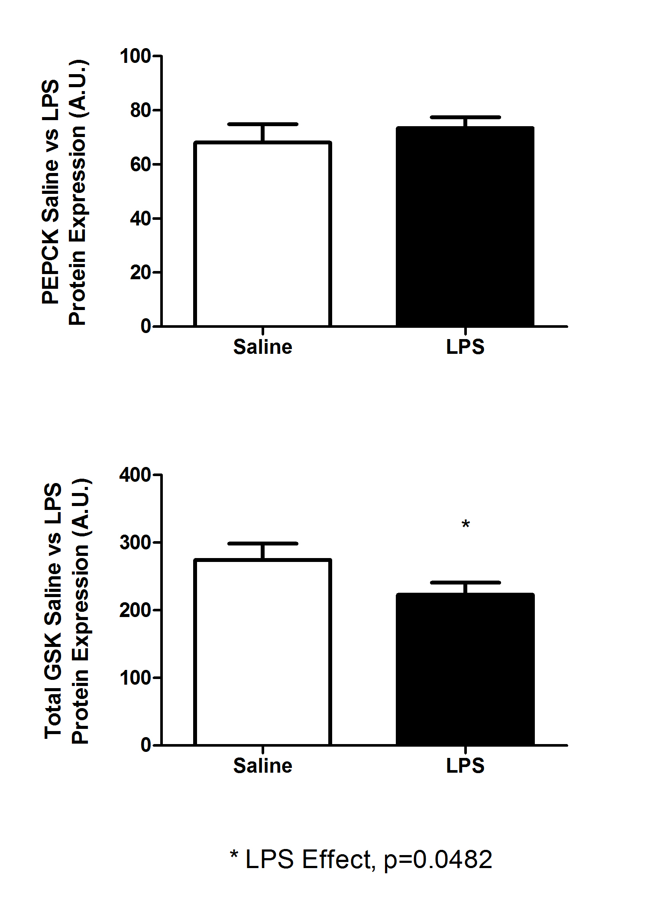

The Role of Hepatic Glucose Metabolism in LPS-mediated Glucose Clearance
Shannon Lloyd, Justin Resendes, Ryan McMillan, Joey Stevens, and Matthew Hulver
Department of Human Nutrition, Foods, and Exercise
Metabolic Phenotyping Core, Virginia Tech, Blacksburg, VA
Abstract
Preliminary Data
Experimental Approach
Results
Toll-like receptor 4 (TLR4) is integral to an innate immune response and is the receptor for the endotoxin, lipopolysaccharide (LPS) produced from the death of gram-negative bacteria in the gut. Data from the Hulver lab shows low dose treatment with LPS in skeletal muscle cell culture increases glucose oxidation. Additionally, low dose LPS, delivered via intraperitoneal injections, acutely enhances whole-body glucose tolerance in C57Bl/6 mice. The liver plays an essential role in glucose homeostasis by regulating glucose uptake and release when blood glucose is high or low, respectively. There is evidence to suggest the liver is one of the first tissues affected by LPS treatment. The purpose of this study was to evaluate the role of hepatic glucose metabolism in LPS-mediated glucose clearance. The predicted outcomes were that acute LPS exposure, relative to saline controls would more potently 1) suppress transcription and activity of proteins important for hepatic glucose production, and 2) increase transcription and activity of proteins important for glucose uptake and glycogen synthesis. Methods: wild-type (WT) and over-expressing TLR4 C57B1/6 mice were injected with saline or LPS (1 μg/kg BW, ~0.025 μg dose) and glucose (1g/kg BW) four hours post LPS/saline treatment. Mice were euthanized 30 minutes following the injection of glucose and tissues were collected in order to study rate-limiting steps in hepatic glycolysis, glycogen synthesis and gluconeogenesis using rt-PCR and Western Blotting techniques. These studies will provide insight into the role of gut-derived endotoxin on glucose metabolism in the liver.
In Vivo Studies
% Change relative to Control
-12 h
0
4
4:30
LPS
fast
GTT
sac
C57Bl/6
mice
ACUTE
treatment
LPS injection
4
saline
-12 h
0
4:30
fast
GTT
sac
Saline injection
Glucose tolerance tests were performed in C57bl/6 mice with skeletal muscle-specific knock-out of TLR4, 4hrs post LPS injection (1 μg/kg BW). Top figures represent glucose clearance data from WT and KO mice treated with either saline or LPS while bottom is comparison of Saline vs LPS treatment groups independent of genotype.
C57B1/6 mice were injected with saline or LPS (1 μg/kg BW) and glucose (1g/kg BW) four hours post LPS/saline treatment. Mice were euthanized 30 minutes following the injection of glucose, liver tissue was harvested in trizol and RNA was extracted. mRNA levels were measured for target genes (Glut2, Gys2, Gckr, Pklr, Phkg1, Pyg1) and corrected for Rpl19 mRNA levels.
Endpoint Measures
Hepatocyte
PEPCK Protein Expression
Glucose
WT Saline
WT LPS
Tg
Saline
Tg LPS
Introduction
Glut2
PEPCK
mRNA and Protein:
Glut2
Pyruvate Kinase (Pklr)
PEPCK
Glycogen Synthase
GSK
Glycogen Phosphorylase
Phosphorylase Kinase
GAPDH Expression
Lipopolysaccharide (LPS) is produced from the death of gram-negative bacteria in the gut. LPS is released into the blood and activates its receptor, toll-like receptor 4, (TLR4) in metabolic tissues and initiates an inflammatory response.
Data from the Hulver lab shows low dose treatment with LPS in skeletal muscle cell culture increases glucose oxidation.
Low dose LPS, delivered by intraperitoneal injection, acutely enhances whole-body glucose tolerance in C57B1/6 mice.
The liver is essential in the regulation of glucose homeostasis, and there is evidence to suggest the liver is one of the first tissues affected by LPS.
The purpose of this study was to evaluate the role of hepatic glucose metabolism in LPS-mediated glucose clearance.
Four hours post low dose (1 μg/kg BW) LPS injection, mice were given a glucose injection (1g/kg BW) and sacrificed 30 mins later. Blood was collected and insulin measured.
WT Saline
WT LPS
Tg
Saline
Tg LPS
Gckr
G-6-Phosphatase
Total GSK Protein Expression
WT Saline
WT LPS
Tg
Saline
Tg LPS
Hypothesis
PFK
F-1,6-Bisphosphatase
GAPDH Expression
WT Saline
WT LPS
Tg
Saline
Tg LPS
Acute LPS exposure, relative to saline controls would:
Phosphoenolpyruvate
transcription and activity of proteins important for glucose uptake and glycogen synthesis.
PEPCK
Conclusions/Future Directions
Pklr
Pyruvate Carboxylase
transcription and activity of proteins important for hepatic glucose clearance.
The results suggest LPS has an effect on important enzymes involved in glucose metabolism in the liver:
  Glut2 was significantly down regulated at the mRNA level due to acute LPS treatment. This suggests glucose uptake in the liver is down regulated.
  At both the mRNA and protein level glycogen synthase was down regulated, suggesting that when LPS glycogen synthesis is being down regulated in the liver.
Tissue collection and data analysis of mRNA and protein target molecules will continue in order to discern the effects of acute LPS on glucose metabolism in the liver.
C2C12 cells were treated with LPS (50 pg/ml) for 2 hours followed by measures of glucose and fatty acid oxidation using [U-¹⁴C]-glucose and [9,10-³H]-palmitic acid, respectively.
Pyruvate
The Gut
Acute ⬆
LPS
Blood Vessel
Phosphorylase Kinase
G-1-P
Phosphorylase Kinase
Hepatocyte
Glucose
Glycogen Synthase
Glycogen Phosphorylase
TLR4
+P
+P
Glut 2 Vesicle
GSK
Glycogen
GSK

